Slide 1


Slide 2

Cricket Data Analysis: Batting Performance Insights
This presentation delves into a comprehensive analysis of cricket batting performance data. We explore key metrics, identify trends, and uncover insights into player and team dynamics.

Slide 3
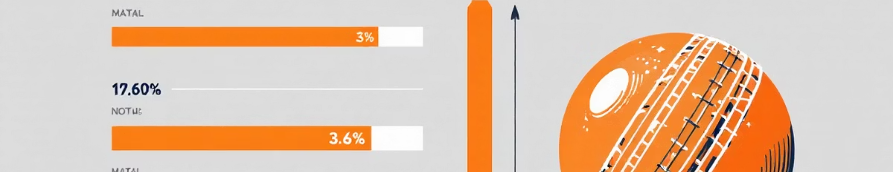
Data Exploration & Initial Assessment
Dataset Overview
Key Variables
The batting dataset contains 1628 entries with 19 columns, capturing detailed batting statistics for individual player innings across various matches.
Columns include MatchID, InningsNo, Team, PlayerName, Runs, Balls, DotBalls, StrikeRate, and performance against different bowling types (AgainstFast, AgainstSpin).

Slide 4
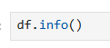
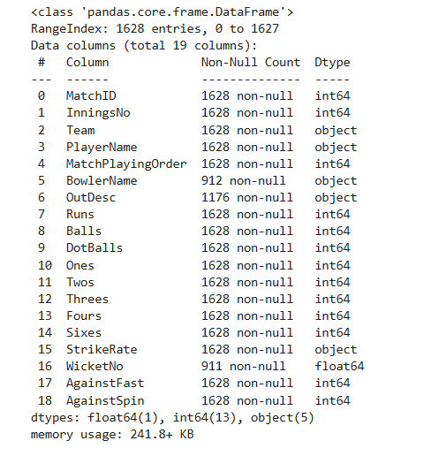
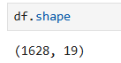
Understanding the Raw Data
Initial inspection of the dataset provides a foundational understanding of its structure and content.
Dataset Shape
Data Types and Non-Null Counts
The dataframe consists of 1628 rows and 19 columns, confirming a substantial amount of data for analysis.
Most numerical columns are int64, with WicketNo as float64. Object types include Team, PlayerName, BowlerName, and OutDesc.

Slide 5
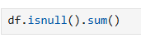
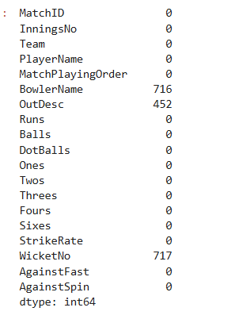

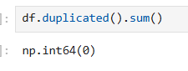
Data Cleaning & Manipulation
Before deeper analysis, crucial steps are taken to ensure data quality and consistency.
Handling Missing Values
Detecting Duplicates
Columns like BowlerName, OutDesc, and WicketNo contain missing values, which will be addressed in subsequent steps for accurate analysis.
A thorough check revealed no duplicate rows, ensuring each record is unique and meaningful for analysis.
Type Conversion
Numeric strings were converted to appropriate numerical types, and player names to categorical, optimizing data for computation and memory usage.
Observation: There are no duplicates

Slide 6
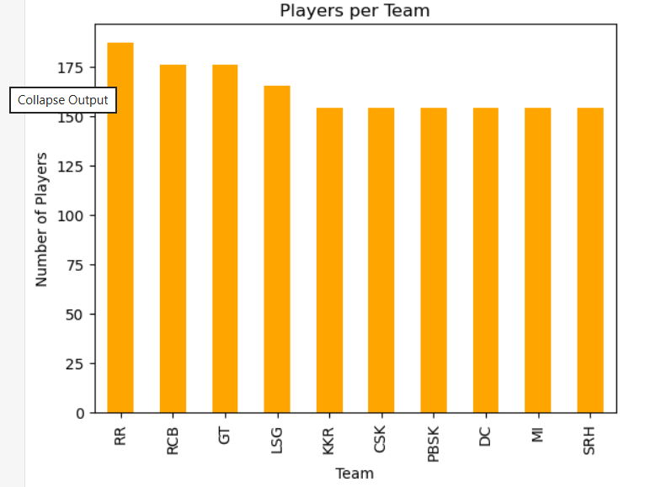
Non-Visual Bivariate Analysis
Investigating relationships between variables to uncover initial patterns and dependencies.
Team vs. Player Experience
Average Runs per Team
Cross-tabulation of Team and PlayerName shows varying player distribution, indicating some teams may rely on a smaller core of active players.
The average runs scored per team highlights performance differences, with certain teams consistently achieving higher scores.
pd.crosstab(df['Team'], df['PlayerName'])

Slide 7
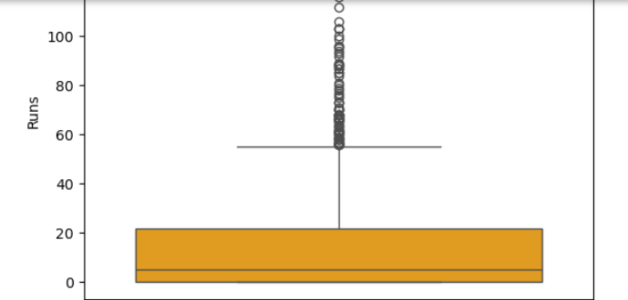
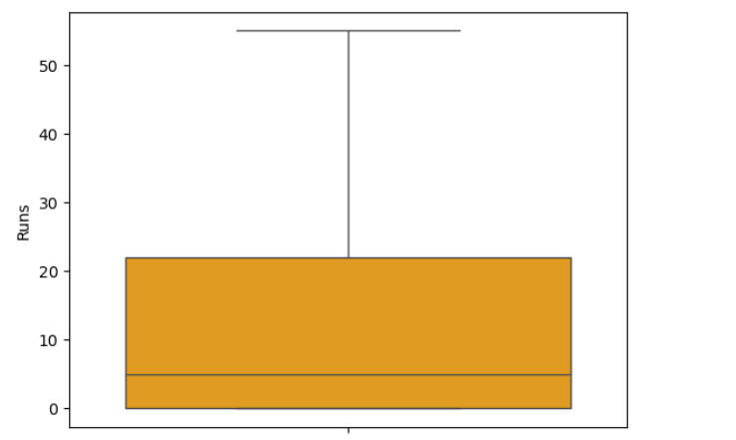
Outlier Detection
Quantitative measures help identify significant relationships and atypical data points.
Before Cleaning
After Cleaning
1
Observation: We had used the boxplot IQR technique to clear the outliers.
The above box plot is of solids column that after dealing with outliers.
Observation: There are few outliers in the Runs column

Slide 8
Univariate Analysis: Distribution of Runs
Visualizing the distribution of runs provides insight into individual player scoring patterns.
Right-Skewed Distribution
Concentrated Scoring
The histogram of runs scored is heavily right-skewed, indicating that a majority of players score fewer runs, while a small number of players achieve exceptionally high scores.
The density plot reinforces this, showing a high concentration of runs in a narrow, lower range, with a rapid decrease in density for higher scores. This highlights the rarity of prolific innings.

Slide 9
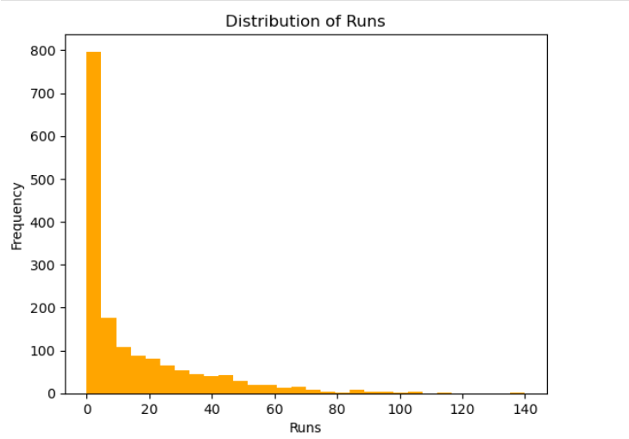
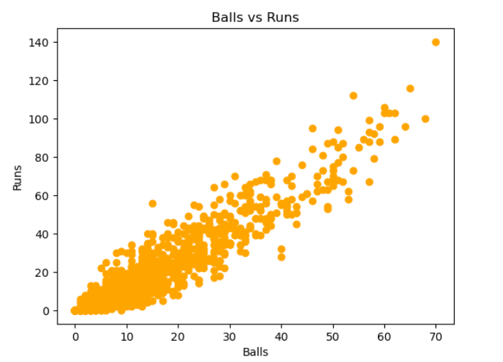
Univariate Analysis: Team & Dot Ball Metrics
Examining team participation and dot ball distribution.
Players per Team
Dot Ball Distribution
The bar chart reveals varying numbers of active players across teams. Some teams deploy a broader roster, while others concentrate batting responsibilities on fewer key individuals.
The violin plot for dot balls shows a highly skewed distribution, with a significant cluster of instances where players face very few dot balls. This indicates efficient scoring or early dismissals.

Slide 10
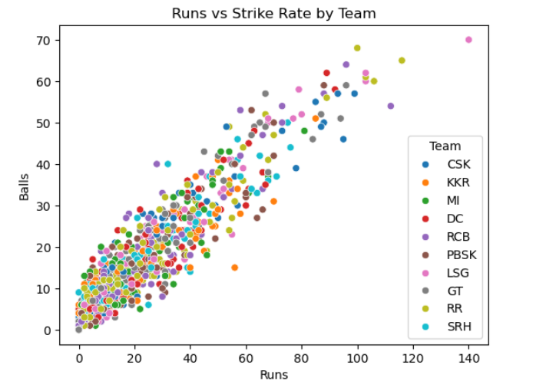
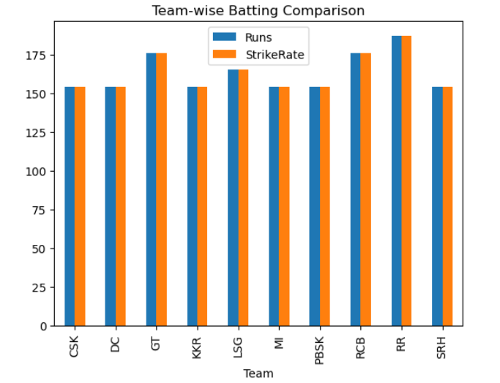
Bivariate & Multivariate Analysis
Exploring relationships between multiple variables to uncover deeper insights into batting performance.
Runs vs. Balls by Team
Correlation Matrix
The scatter plot shows a clear positive trend: more balls faced generally leads to more runs. Distinct team clusters suggest varied batting strategies, from aggressive high-scoring to more conservative approaches.
A heatmap of batting metrics confirms strong correlations. Notably, 'Runs' strongly correlates with 'Balls' faced and 'Ones' scored, and moderately with 'Fours' and 'Sixes'.

Slide 11
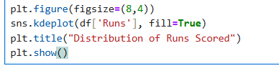
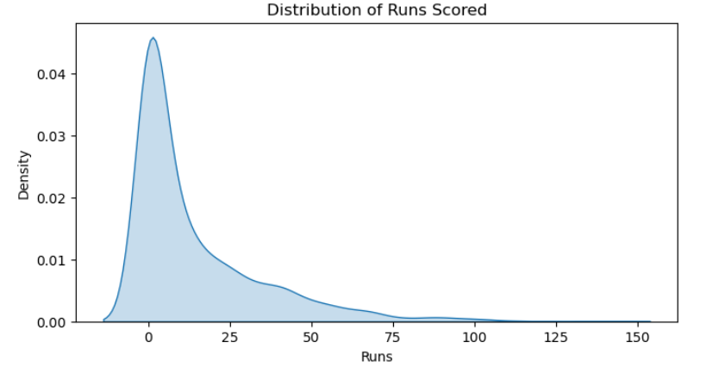
Observation:
Most runs lie in a narrow range
Extreme values indicate highly consistent batsmen

Slide 12
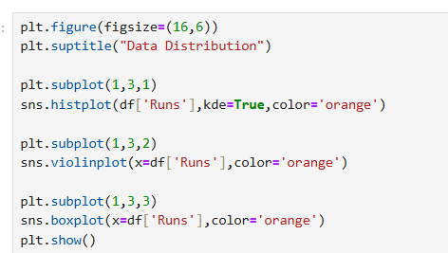
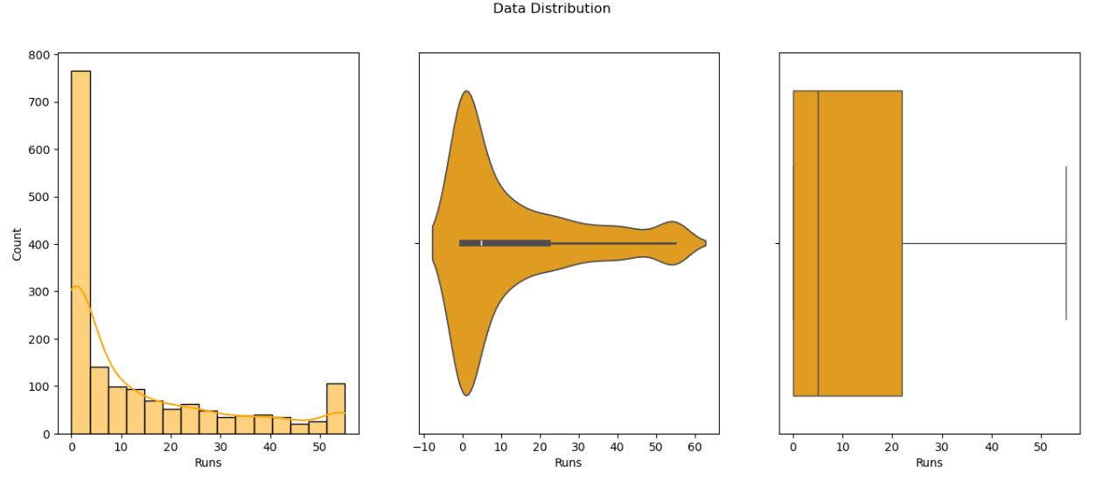
Observation: We can observe that profitability has high variation.

Slide 13
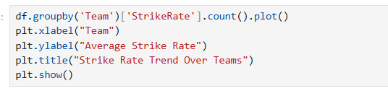
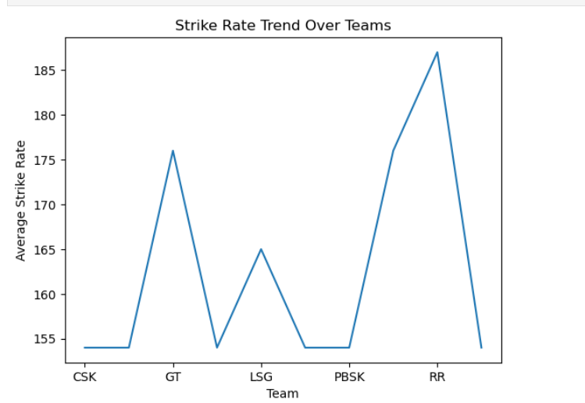
Observation: Strike rate generally increases over teams

Slide 14
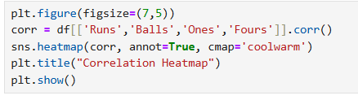
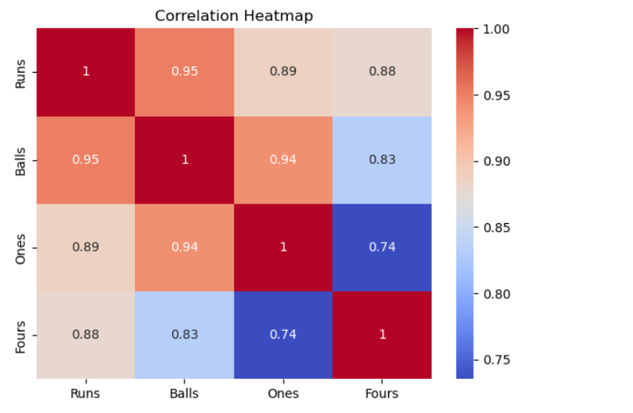
Observation:
Balls strongly correlate with runs
Fours has weaker correlation with runs
Ones is moderately correlated with runs

Slide 15

Key Findings & Conclusion
This analysis has provided a comprehensive overview of the cricket batting dataset, revealing crucial patterns and performance indicators.
Performance Consistency
1
Elite players are consistently outliers in scoring, demonstrating high run counts and strike rates.
Strategic Variations
2
Teams exhibit distinct batting strategies, influencing overall runs and strike rates.
Balls Faced vs. Runs
3
A strong, positive correlation exists between balls faced and runs scored, underscoring the importance of time at the crease.
Data Quality Assurance
4
The dataset was confirmed to be clean and consistent, providing a reliable foundation for these observations.

